Slide 1




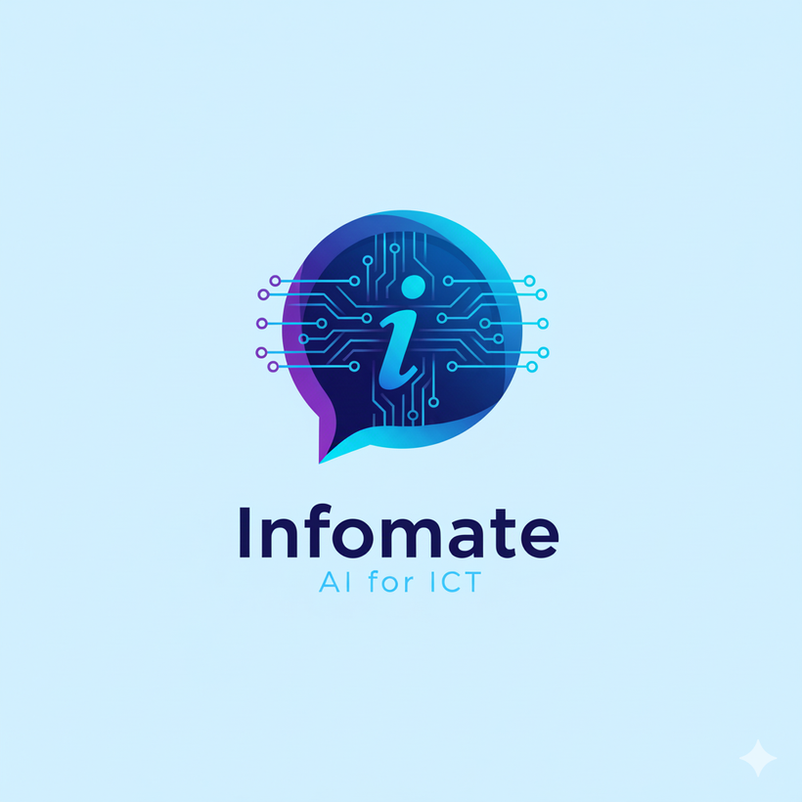
INFOMATE
AN AI-POWERED INFORMATION ASSISTANT FOR THE ICT DEPARTMENT
Course: ICT Engineering Capstone (2025-26)
Prepared by : Prashant Sarvaiya & Ronit Motivaras

Slide 2
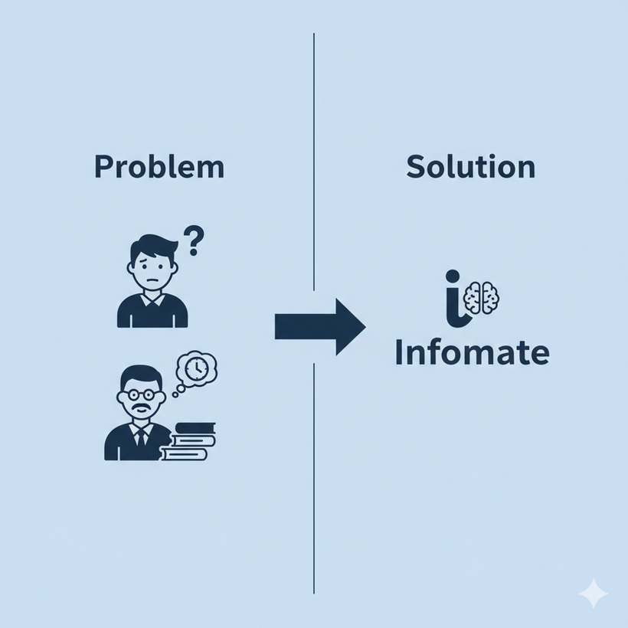

Introduction
Infomate is a web-based chatbot for the ICT department that acts as a centralized and interactive information assistant.
The Challenge : For students, new admits, and external visitors, getting timely and accurate answers to department-related questions can be challenging. In turn, this creates additional work for faculty and administrative staff, who are often left to answer repetitive questions.

Slide 3


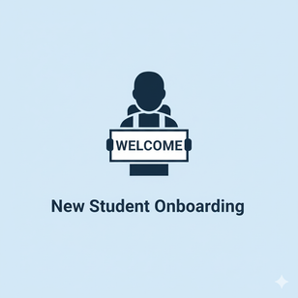
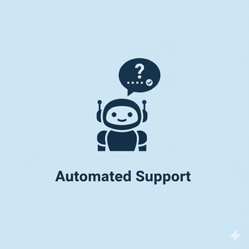

Provide a centralized, accessible, and interactive platform for department information
Assist new admissions in easily understanding facilities, faculty, labs, and placements.
Objectives
Reduce the workload on faculty and administrative staff by automating FAQs.
Establish a digital-first communication channel for students, staff, and visitors.

Slide 4
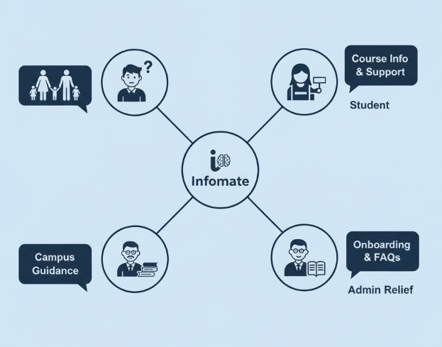
Target Users & Their Needs
Students: Need quick access to academic and administrative information without dependency on staff.
New Admissions: Require a hassle-free way to understand department offerings, faculty, labs, and placements.
Department Staff: Benefit from reduced repetitive queries, allowing them to focus on core tasks.
Guests/Parents: Need an easy way to interact and learn about department facilities and opportunities

Slide 5
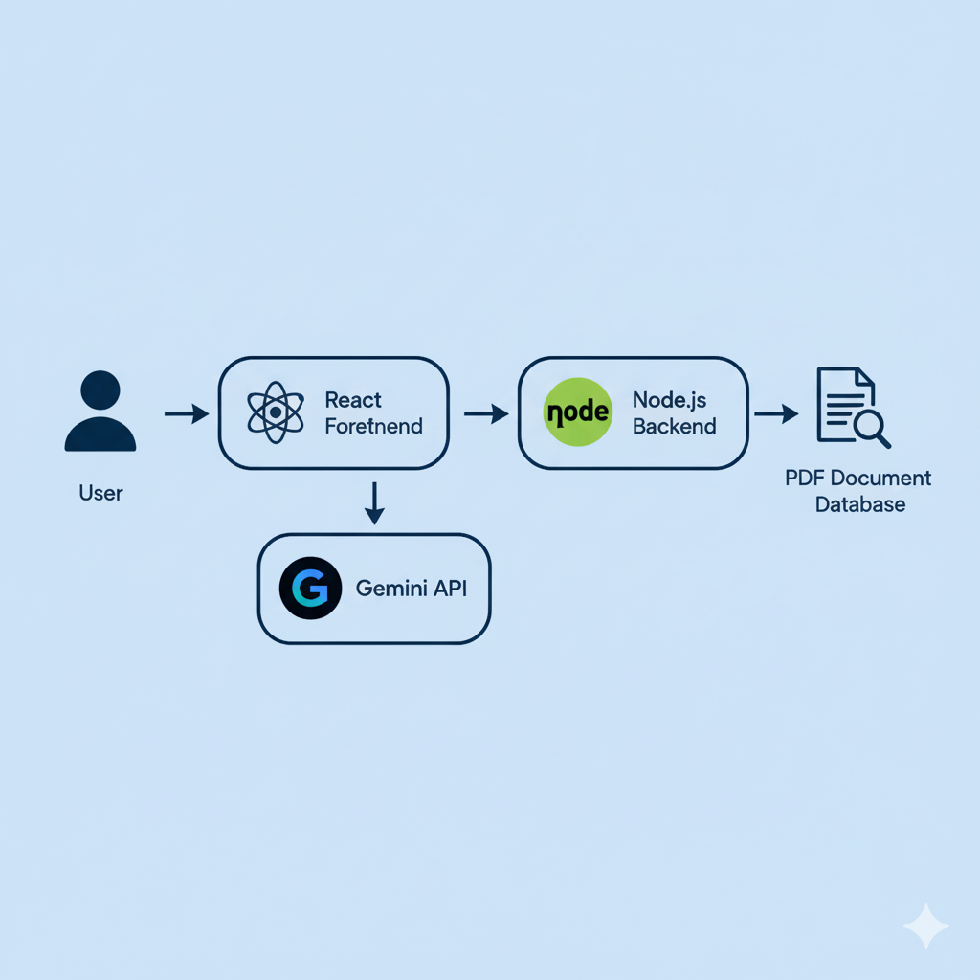
Technical Architecture

Slide 6
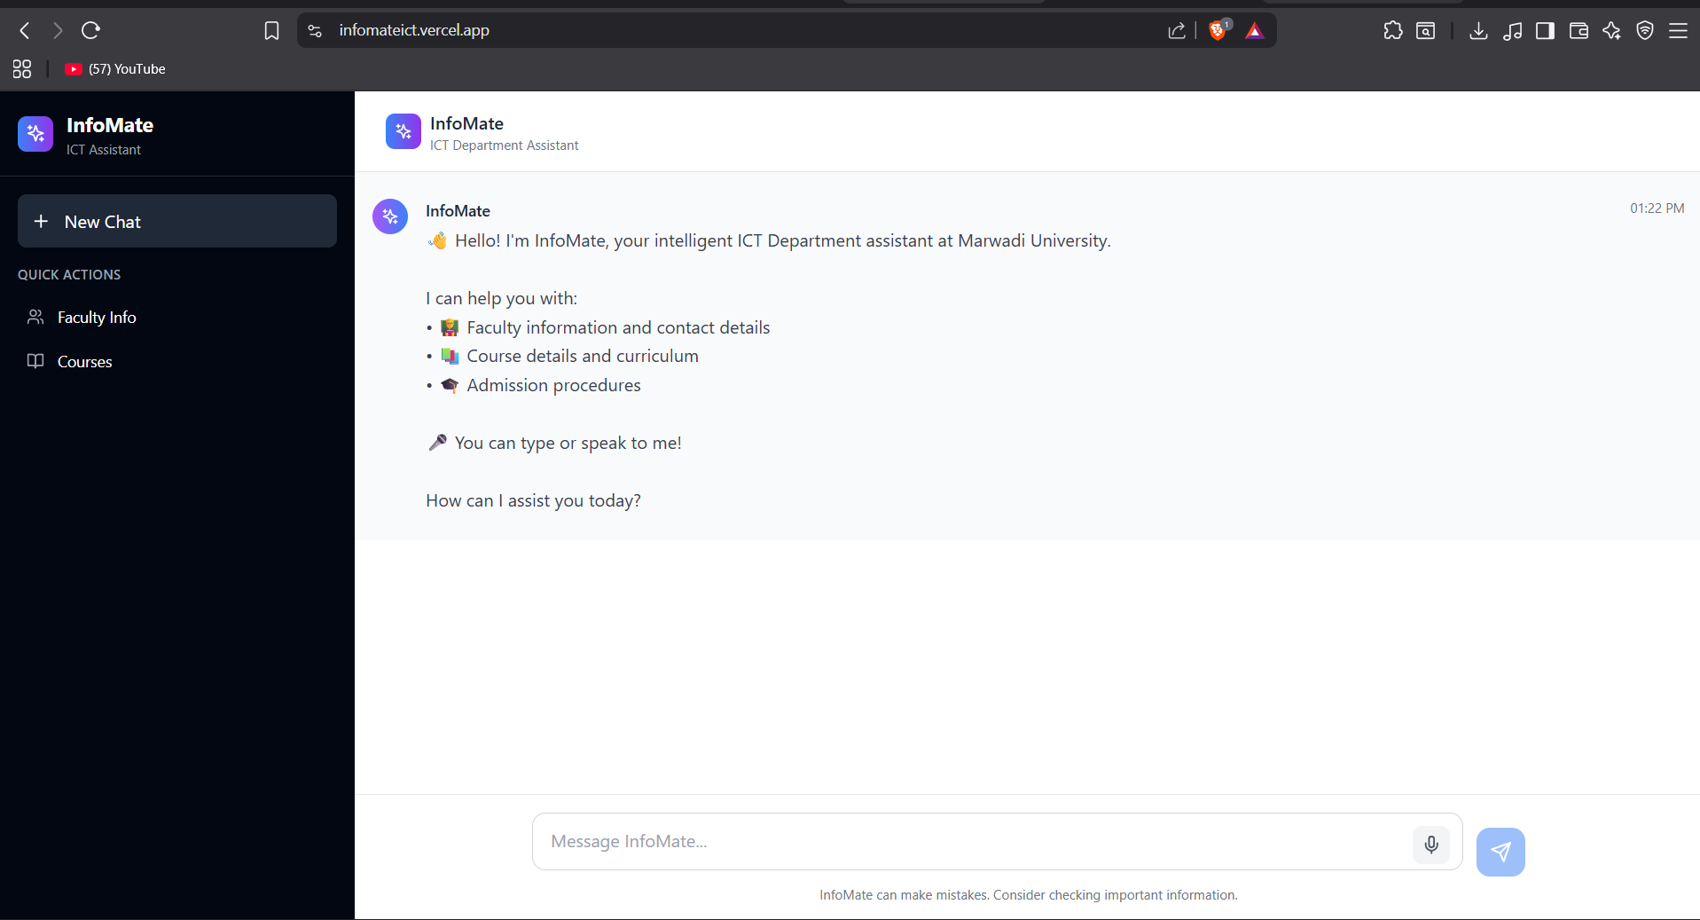

Live Demonstration
http://infomateict.vercel.app

Slide 7
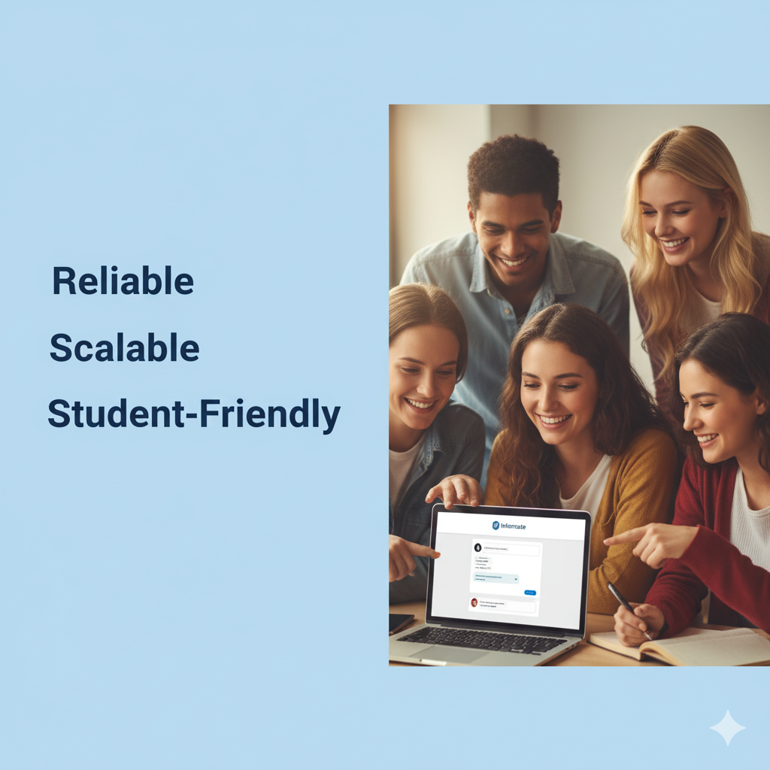
Conclusion
Infomate is a solution that provides the ICT Department with an interactive and reliable information assistant.
It ensures accuracy, easy maintenance, and accessibility by using modern web technologies and AI.
Ultimately, Infomate lays the groundwork for a digital-first, student-friendly school environment.

Slide 8

Thank You

